Slide 1
Prediction of Adult Census Income Level
Tong Wu, Yu Wu, Weizhou Wang, Xiaoyu Wang

Slide 2
Outline
Introduction
Paper reproduce
New approaches
Comparison
Conclusion

Slide 3
Introduction
●Adult dataset is done by Barry Becker from the 1994 Census database.
●Adult dataset contains several attributes of an adult, including work class, education, occupation, work hours and income salary.
●Main prediction task is to determine whether a person makes over 50K a year.
●Our job is to reproduce results from papers which cite this dataset and give other approaches for the prediction.
●We use paper from Bekena [1] and S.deepajothi, D. s selvarajan [2] to reproduce.
●We bring new approaches to the dataset: logistic regression and SVM
Notes:
The dataset we used is adult dataset, which is done by Berry Becker from the 1994 census database. The dataset contains several attributes of the person, including work class, education, occupation, work hours per week and income level. The main prediction task for this dataset is to determine whether an adult makes over 50K a year. Our job is to reproduce the results from two papers, and bring new approaches for this dataset.

Slide 4
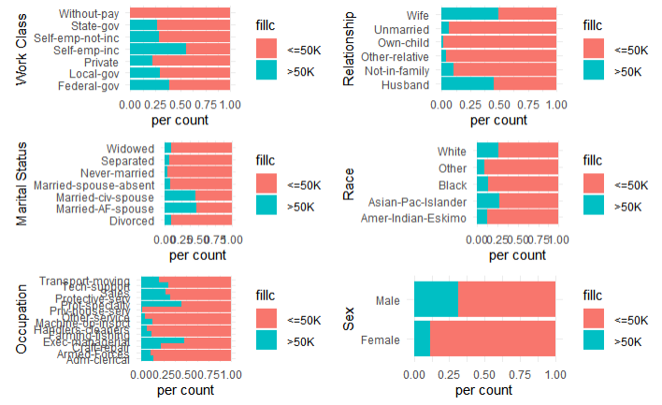
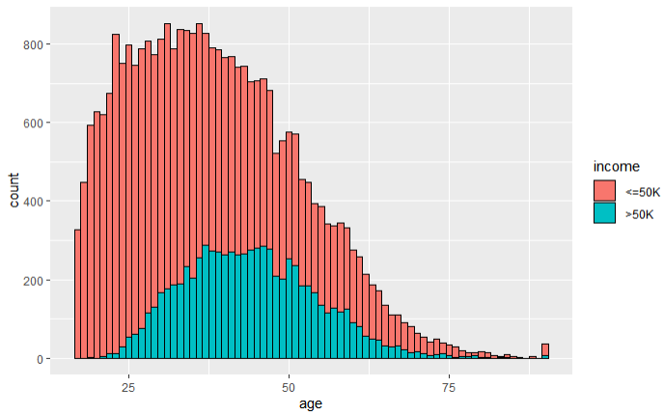
Exploratory Data Analysis (EDA)
Notes:
Before reproducing the paper, we first did the EDA for the dataset, the figures in slide shows the distribution of people with different attribute. From the graph we can see the distribution and relationship clearly. This step allows the data to be visualised and it is essential for the data leaning and validation process.

Slide 5
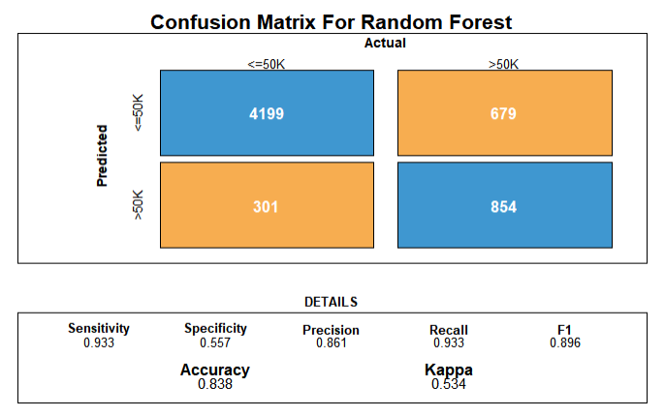
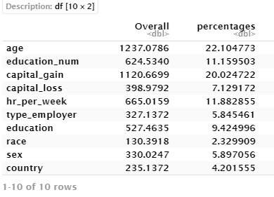
Using decision tree classifier to predict income levels [1]
Paper from Bekena, using random forest classifier to predict the income level. In the paper, the ranking for each attribute according to the importance score is also given.
Notes:
The first paper is called “Using decision tree classifier to predict income levels”. The paper author uses random forest classifier to predict the income level. Also, the ranking of attributes according to the importance score is listed. We plot our reproduction result as below. The left hand side is the confusion matrix, which can see that the random forest classifier has 83.8% of accuracy. The right hand side is the importance score for each attributes. The reproduction result is similar with the paper, the attributes age, education, capital gain and hour work per week occupy the main percentages related to the income level predicting.

Slide 6
A Comparative Study of Classification Techniques On Adult [2]
Paper from S.deepajothi and D. s selvarajan. Used four different algorithms, including naïve Bayesian, Zero R, K-means and Random Forest to compare the accuracy.

Slide 7
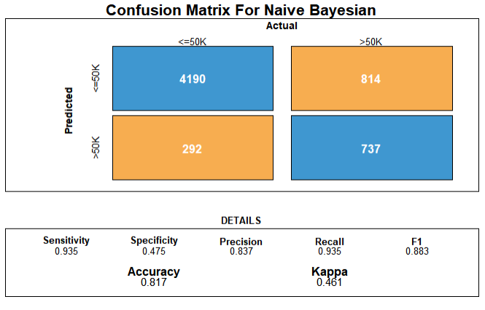
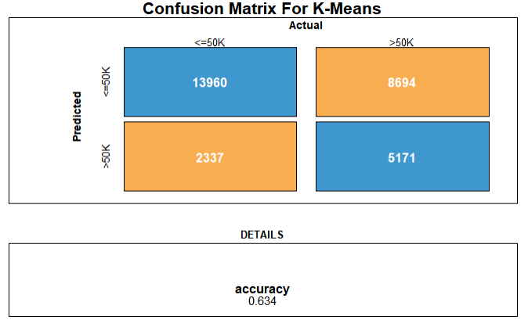
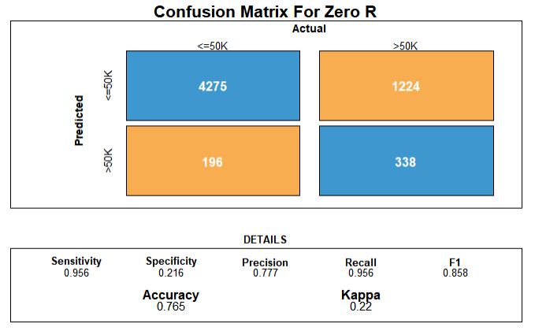
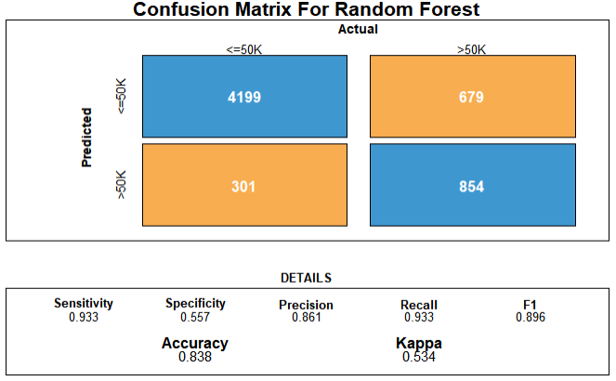
A Comparative Study of Classification Techniques On Adult [2]

Slide 8
A Comparative Study of Classification Techniques On Adult [2]
The result is similar to the paper, where Random Forest and Naive Bayesian has the relative higher accuracy than K-means and Zero R.
The result may because of the high accuracy for Naive Bayesian and Random Forest classifier when dealing with the large-scale data set.
K-means as unsupervised learning, learn from un-tagged dataset. Although dimensionality reduction was already done in the code, the high dimension still drag the accuracy.
Zero R is a naive approach to classify a dataset, which based on target and ignores other independent attributes, so it brings fast computing with relative low accuracy.

Slide 9
New Approaches
Logistic Regression use several independent variables to predict categorical dependent variables. We use Logistic Regression to build the model and predict the income level in order to see the accuracy.
The Support Vector Machine (SVM) can be used to classify the dataset into two groups, which is fit for the adult dataset. The SVM with the principle of a maximum marginal classifier, and a multi-dimensional space to classify data points since the SVM generates a hyperplane in a multi-dimensional space. We use the SVM classifier to build the model and predict the income level in order to see the accuracy of SVM.

Slide 10
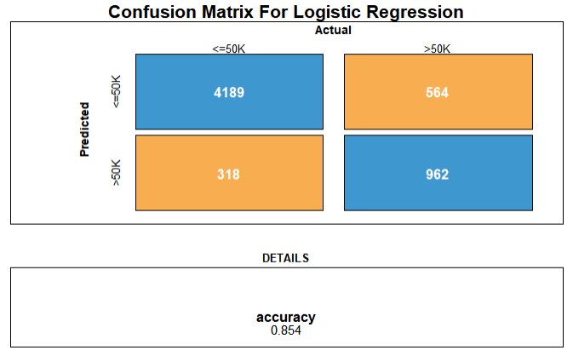
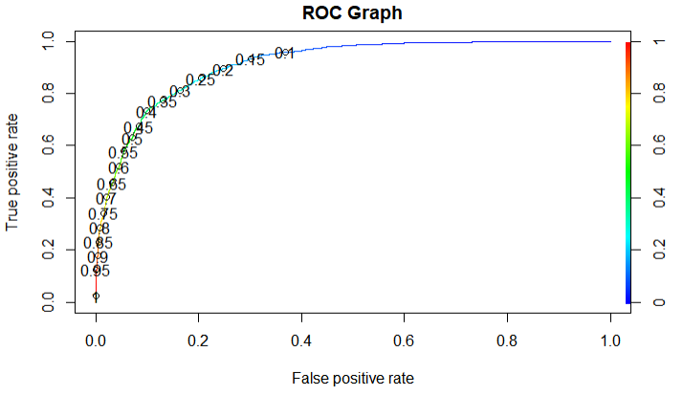
New Approaches – Logistic Regression

Slide 11
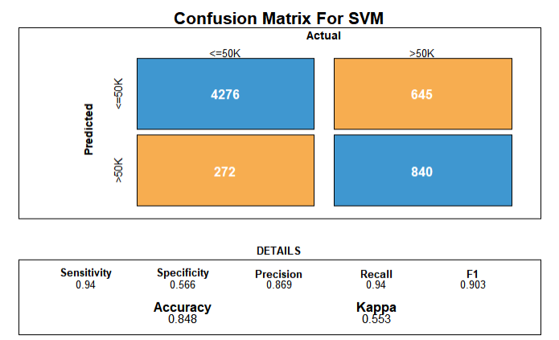
New Approaches - SVM

Slide 12
Comparison
Four algorithms from paper are given different accuracies which are similar to the result of paper.
Two new algorithms from us representing a relatively high accuracy.
Algorithm | Accuracy
Random Forest | 83.8%
Naïve Bayesian | 81.7%
K-means Clustering | 63.4%
Zero R | 74.1%
Logistic Regression | 85.4%
SVM | 84.8%

Slide 13
Conclusion
In this project, we analysis the adult dataset, did exploratory data analysis to visualise the data and did data cleaning for the future algorithm implementation.
We reproduced two papers and got similar results. The first paper introduced random forest classifier and ranked the attributes according to the importance score. The second paper compared four different classifier algorithms’ accuracy.
We also gave two different algorithms, logistic regression and SVM, both representing a relatively high accuracy.

Slide 14
References
[1] Sisay Menji Bekena:“Using decision tree classifier to predict income levels”, Munich Personal RePEc Archive 30th July, 2017
[2] S.deepajothi, D. s selvarajan. (2012). A Comparative Study of Classification Techniques On Adult Data Set. International Journal of Engineering Research, 1(8), 8.

